Slide 1
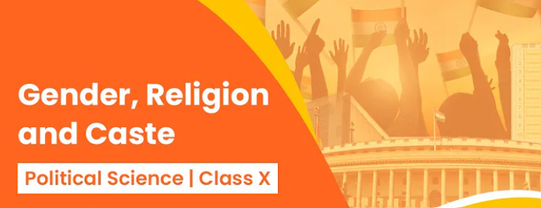

Slide 2
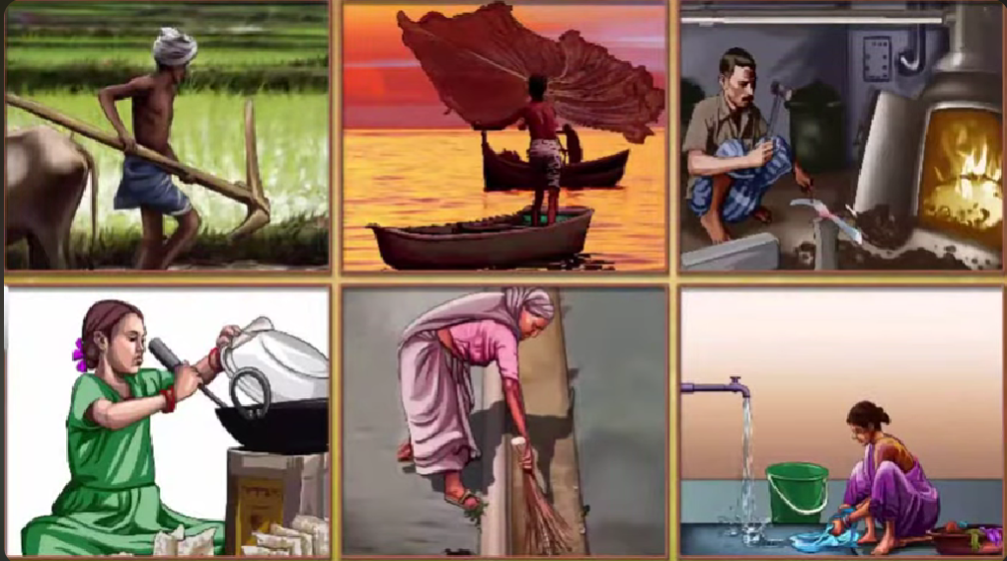

Slide 3
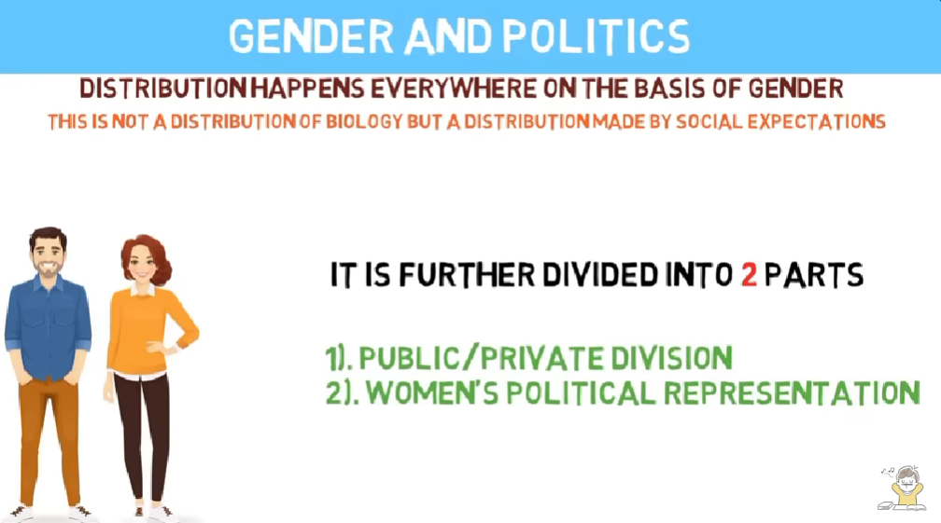

Slide 4
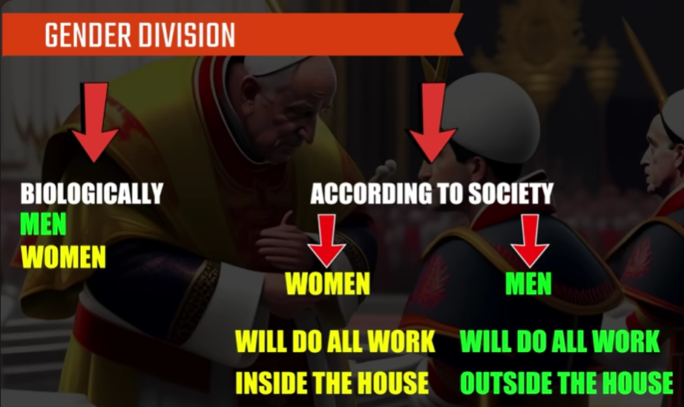

Slide 5
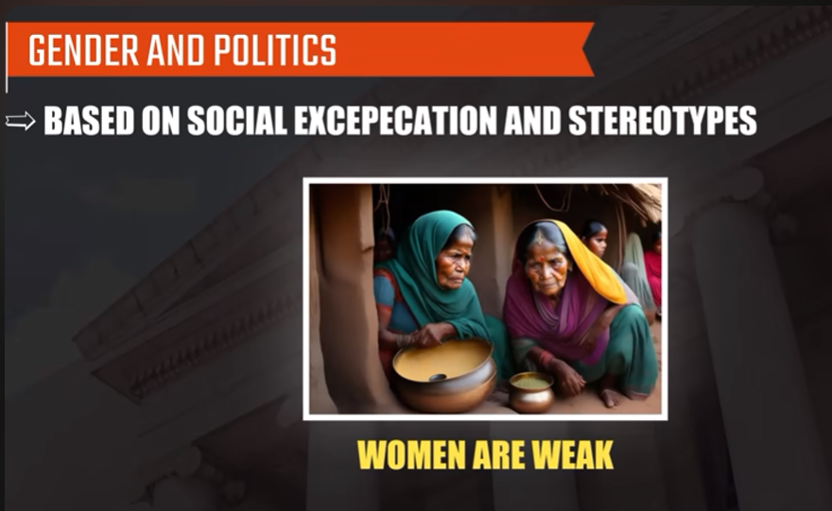
EXPECTATIONS

Slide 6
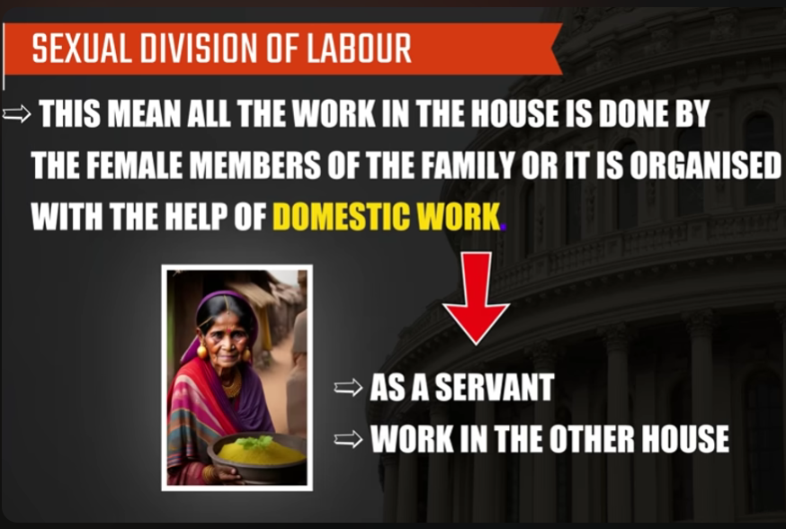

Slide 7
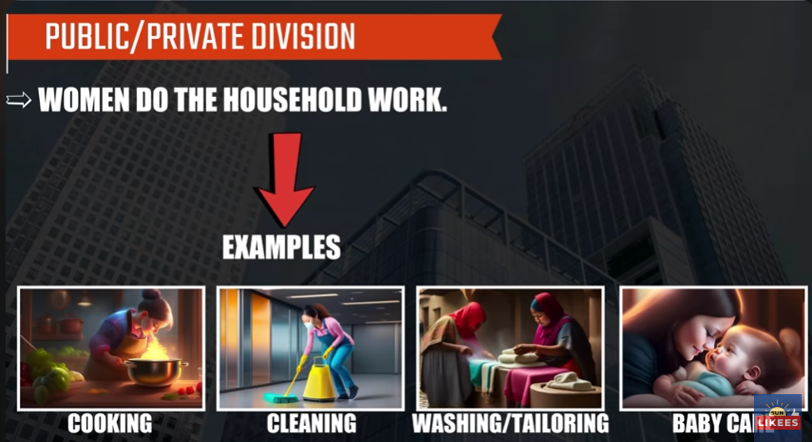

Slide 8
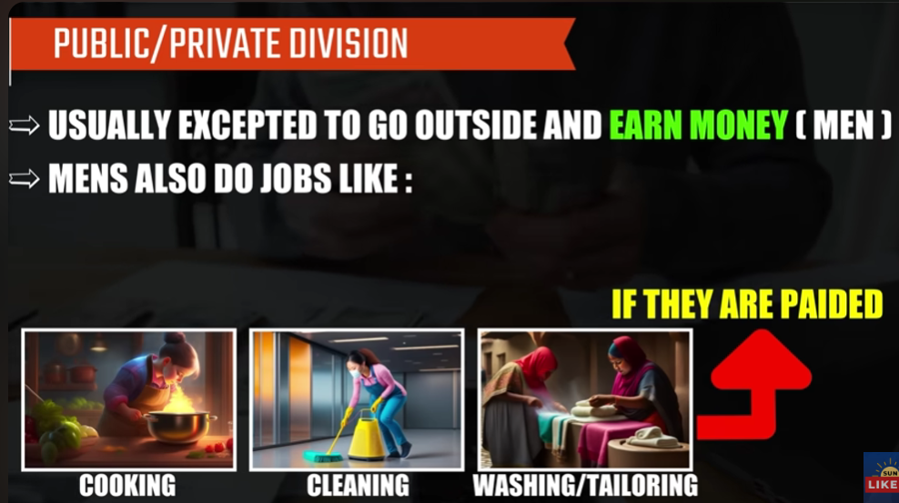
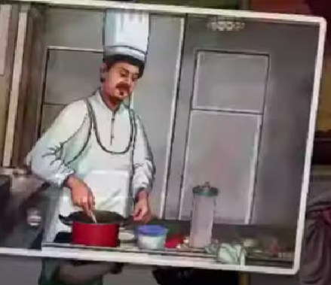
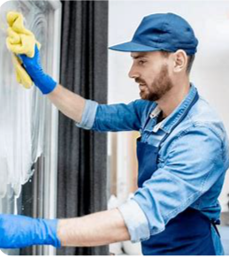
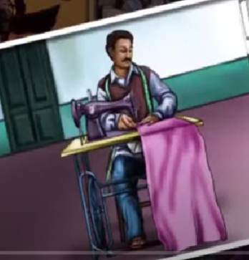
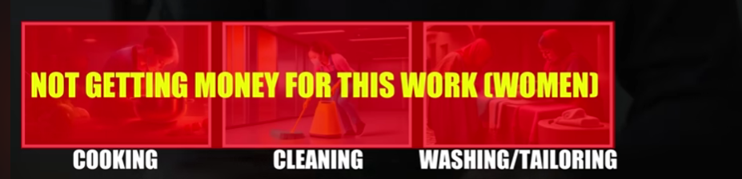

Slide 9
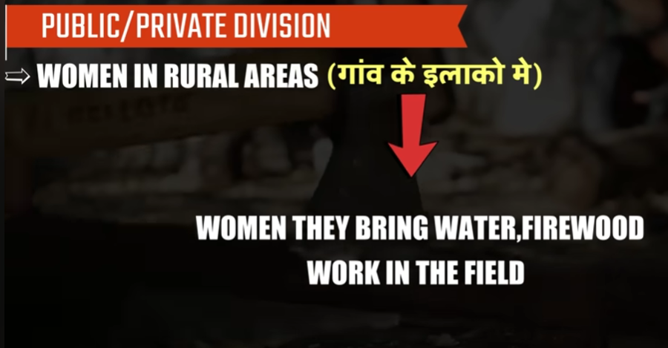
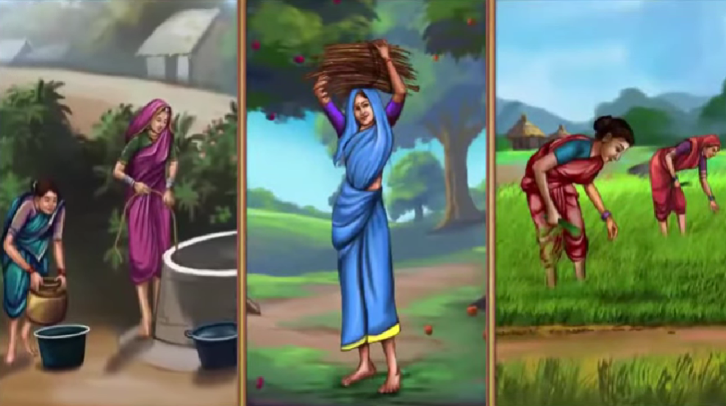

Slide 10
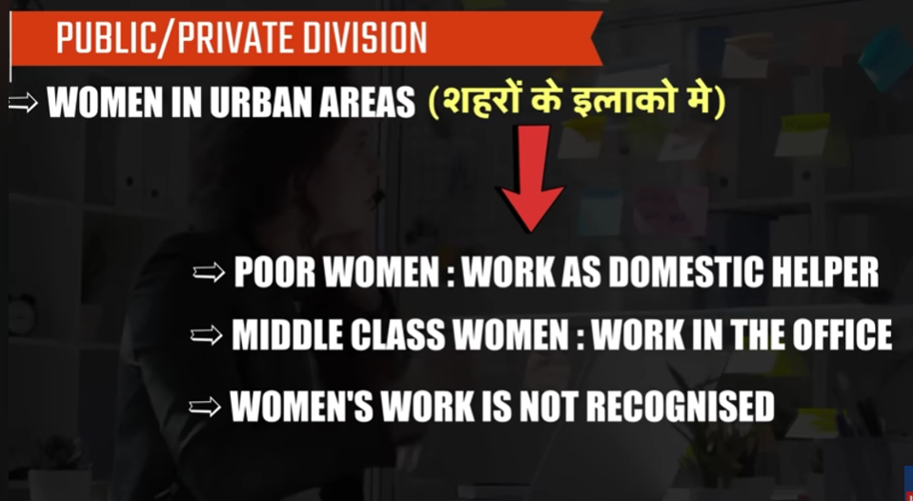
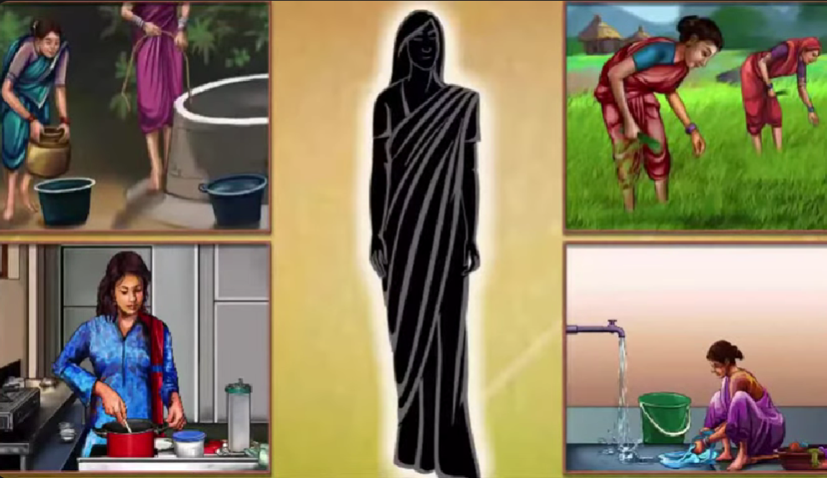
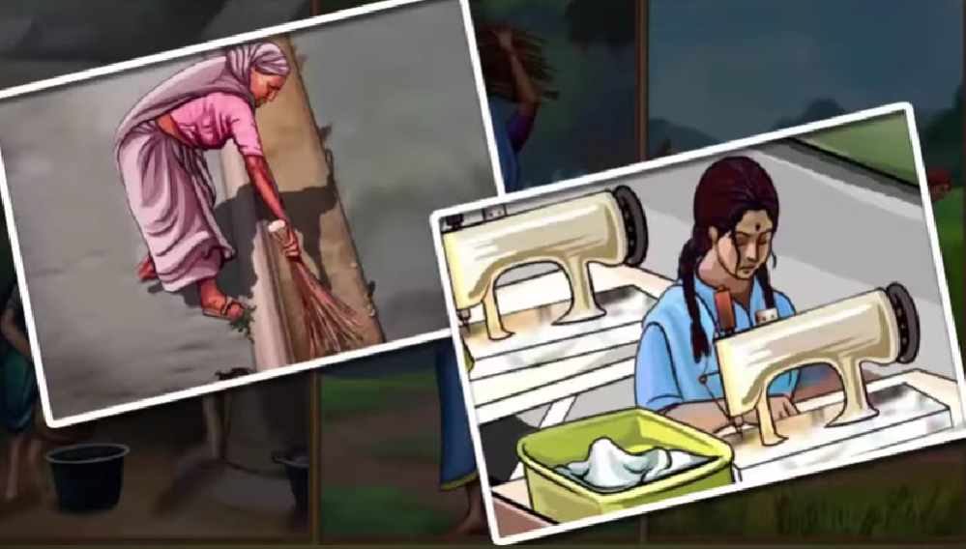

Slide 11
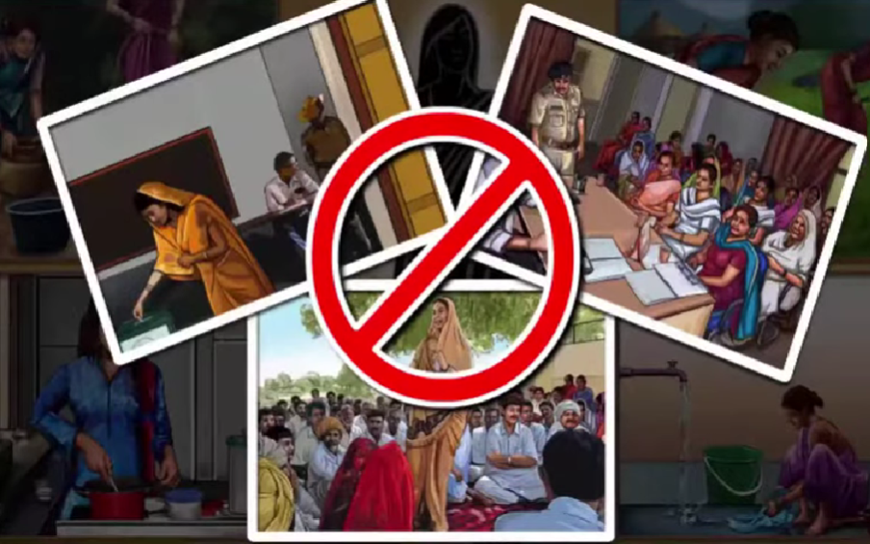
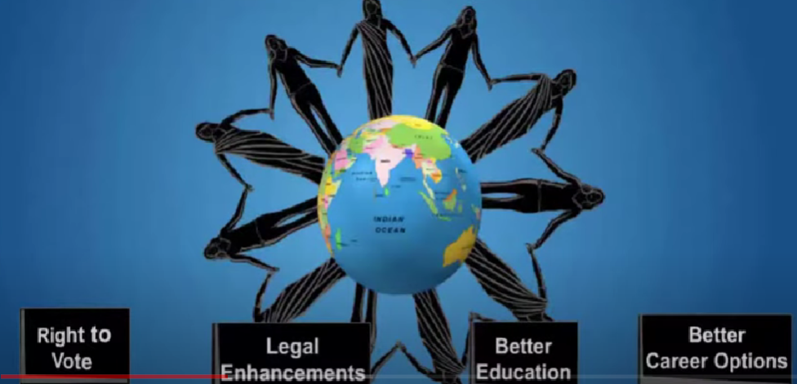

Slide 12
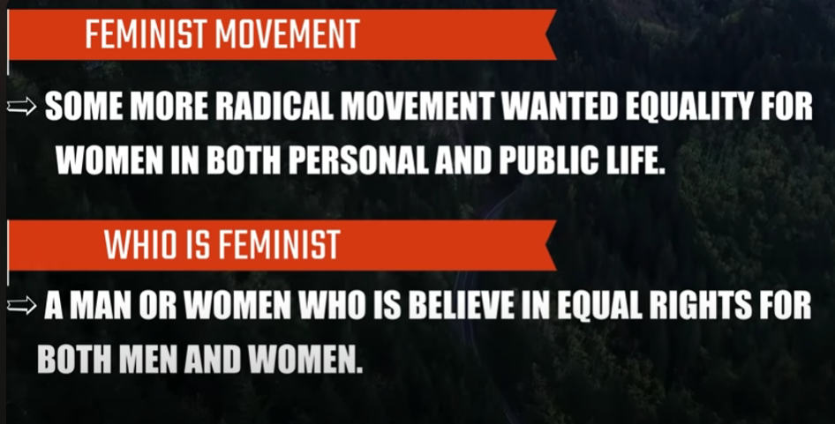

Slide 13
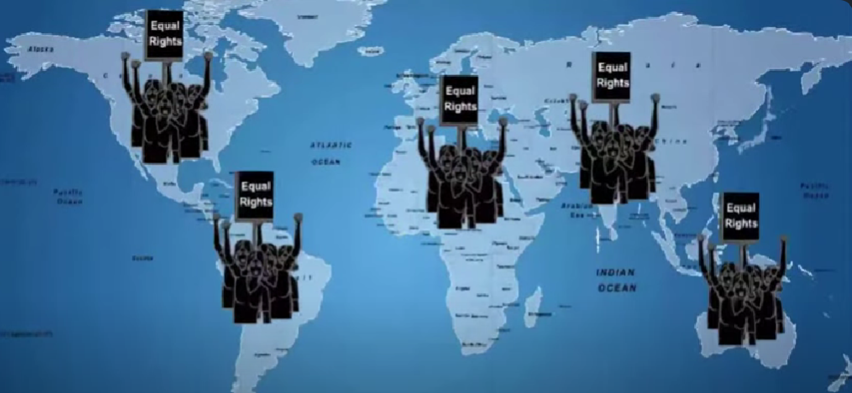
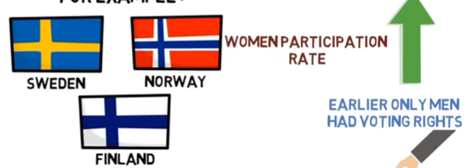

Slide 14
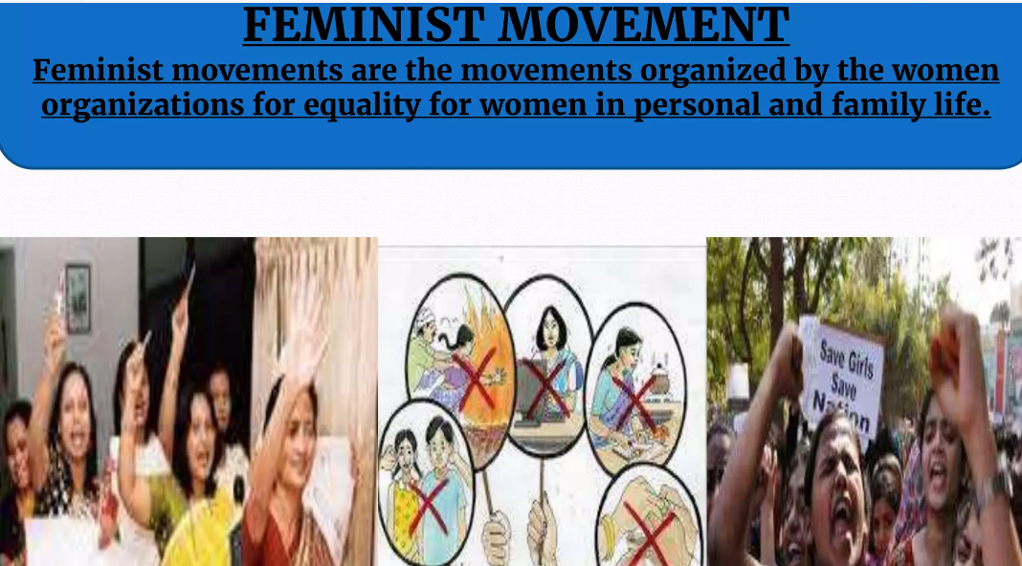

Slide 15
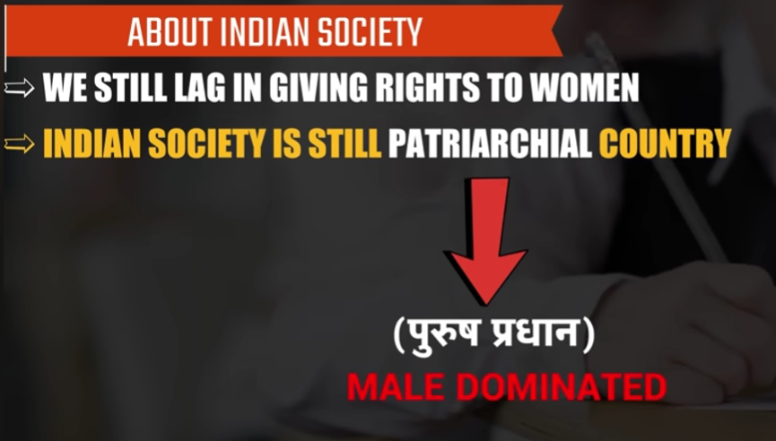
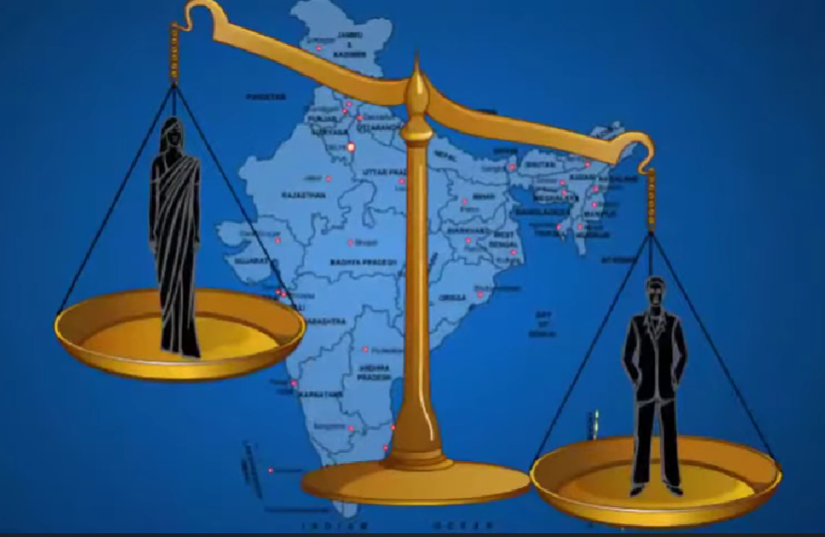
patriarchal

Slide 16
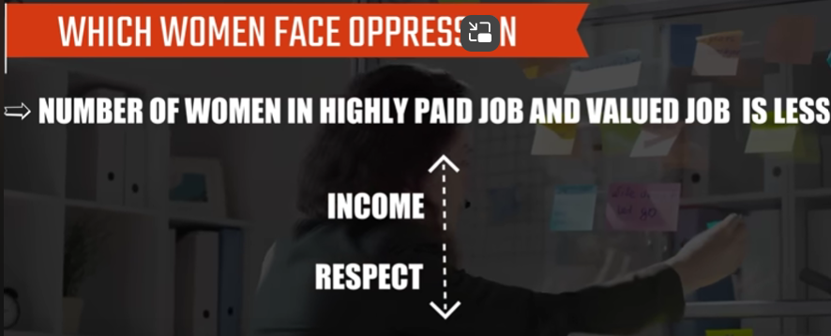
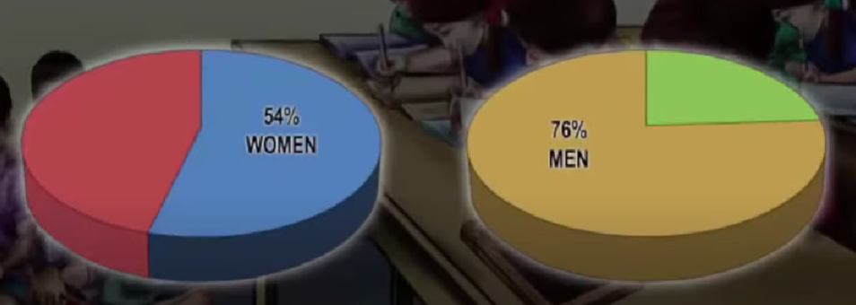
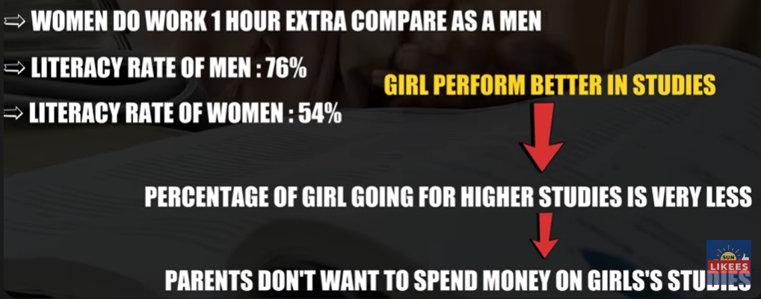

Slide 17
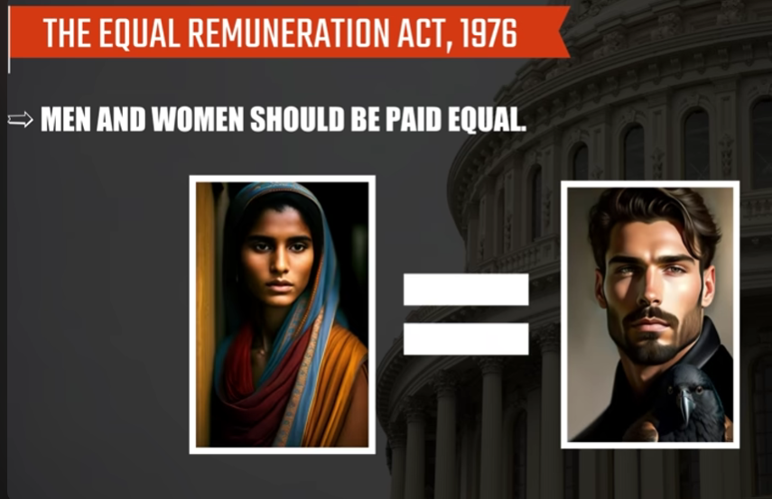

Slide 18
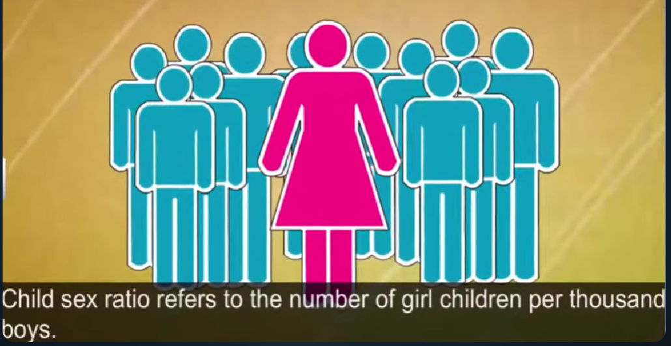
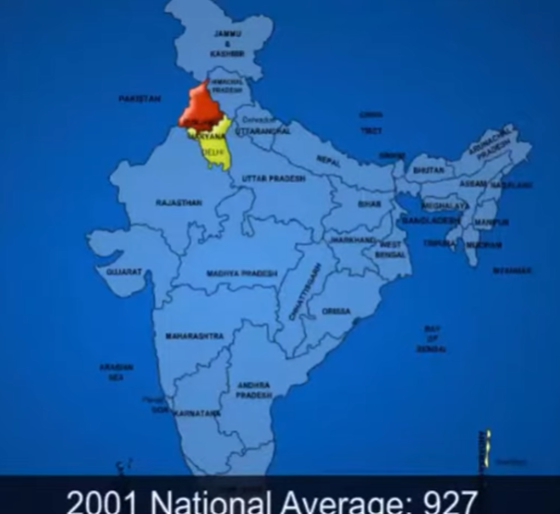

Slide 19
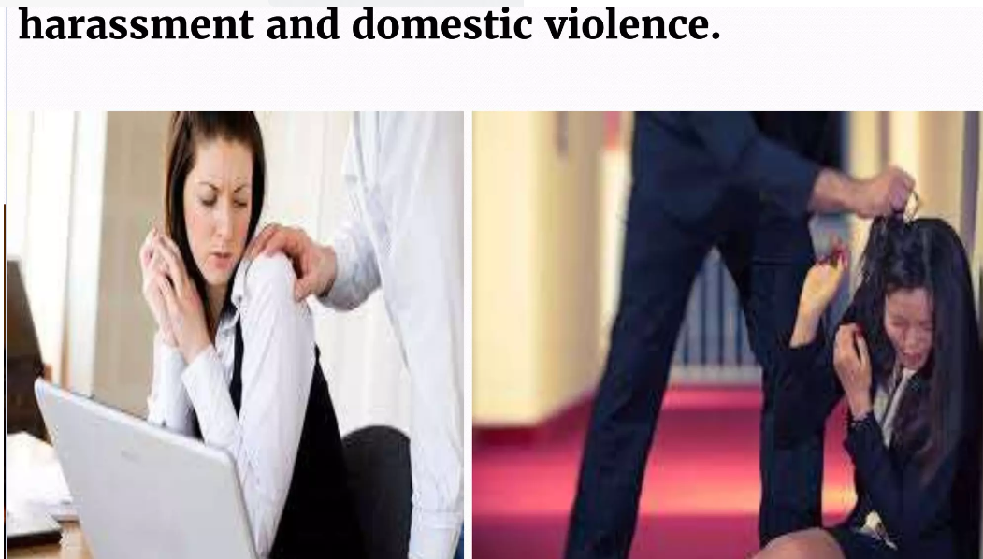

Slide 20
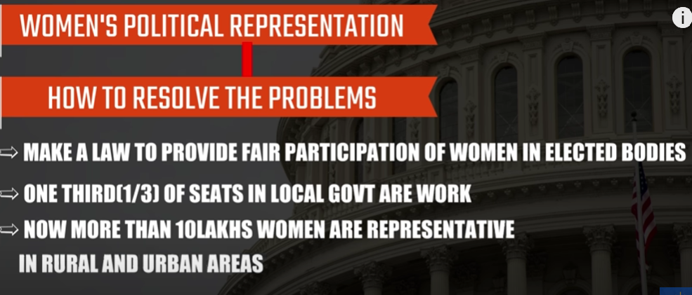

Slide 21
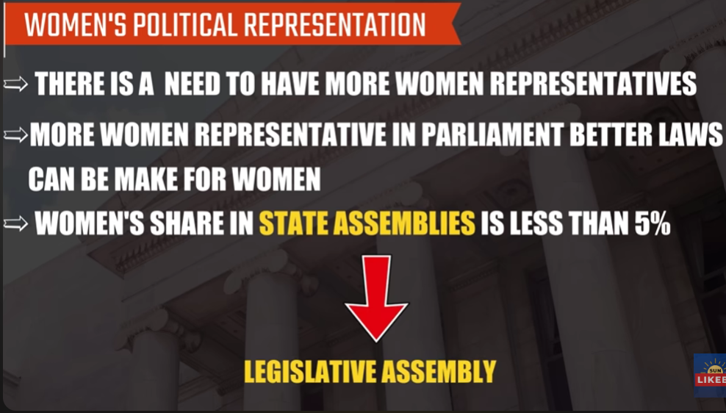
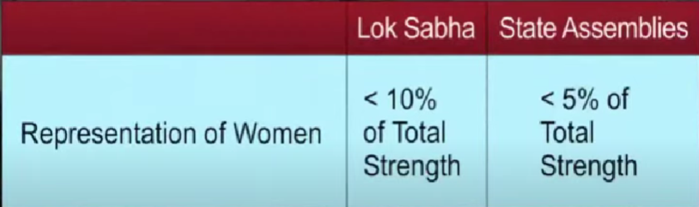

Slide 22
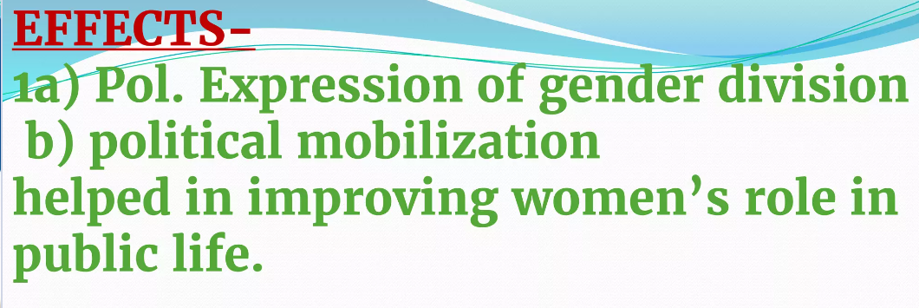
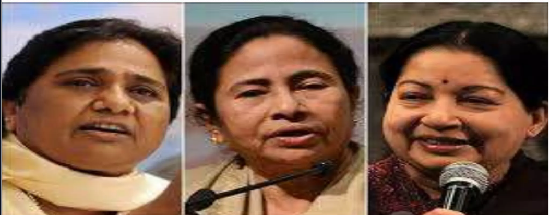

Slide 23
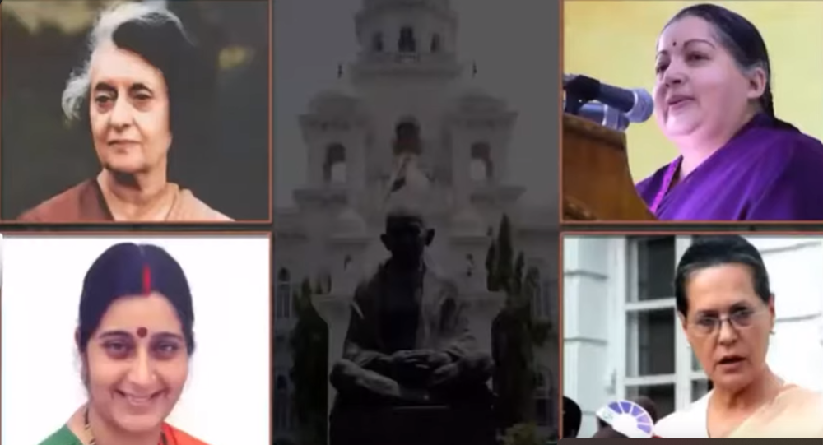

Slide 24
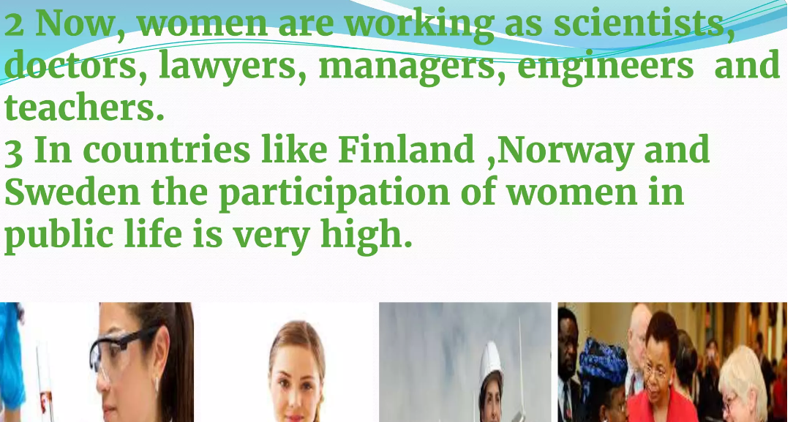

Slide 25
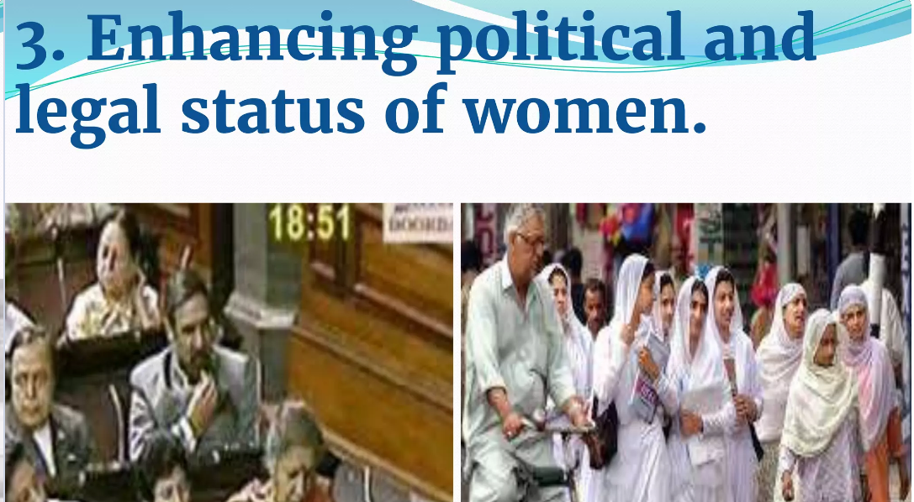

Slide 26
History of women reservation billedit
On 9 December 1946, the inaugural session of the Constituent Assembly of India was convened at the Constitution Hall, presently the Central Hall of the Old Parliament House. Notably, Sarojini Naidu was the only woman in the entire gathering, sitting in the first row of attendees facing the presidential dais. The matter of quota for women was previously deliberated upon in the years 1996, 1997, and 1998; however, it was unable to be pursued further due to the dissolution of Lok Sabha's or the absence of consensus among political parties.

Slide 27
Provisions
The proposed legislation defines the 33% women reservation to continue for 15 years. Additionally, it mandates that a quota for individuals belonging to the Scheduled Castes and Scheduled Tribes be established within the reserved seats designated for women in Parliament and Legislative assembly.
Following legislations
The amendment will only apply to State assemblies, excluding union territory assemblies except for Delhi, which was included in the amendment with a specific provision. However, Puducherry and Jammu & Kashmir union territory assemblies were not included in the amendment.^{[34]} On December 2023, both houses passed the Government of Union Territories (Amendment) Bill and the Jammu and Kashmir Reorganisation (Second Amendment) Bill which would extend women reservation in the union territories of Puducherry and Jammu & Kashmir.

Slide 28

The only 2 votes against the bill came from All India Majlis-e-Ittehadul Muslimeen MPs Asaduddin Owaisi and Imtiaz Jaleel, who demanded the inclusion of OBC reservation in the bill.

Slide 29
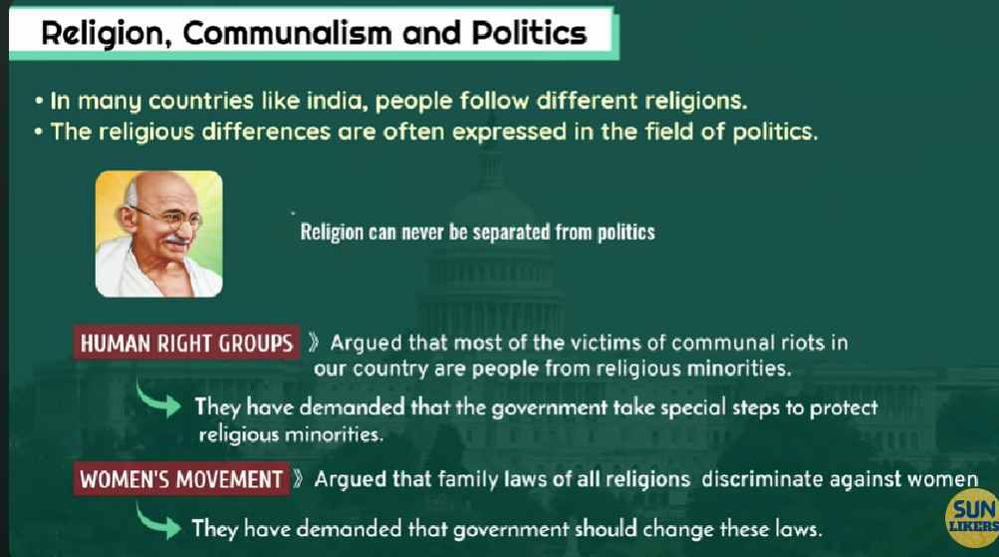

Slide 30
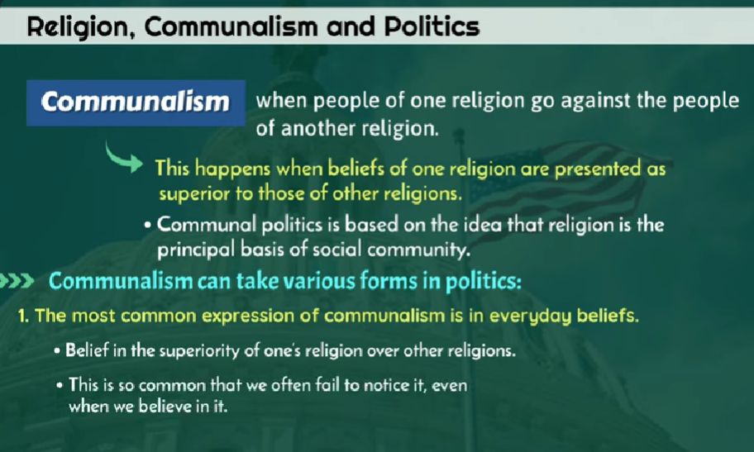

Slide 31
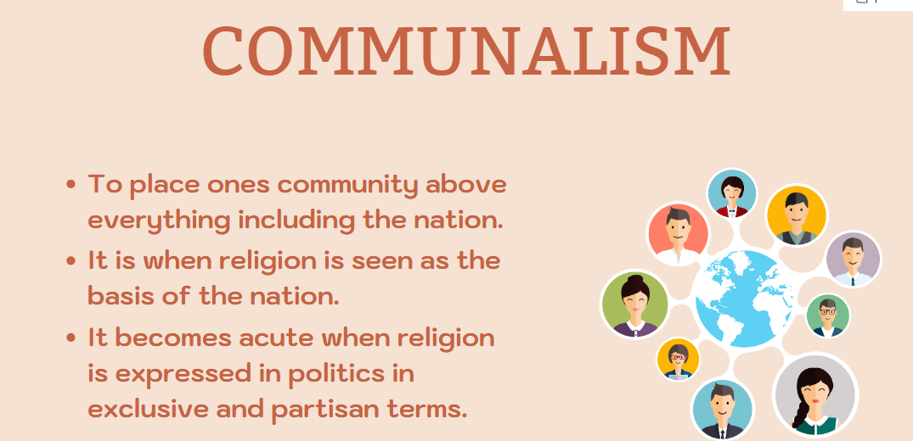

Slide 32
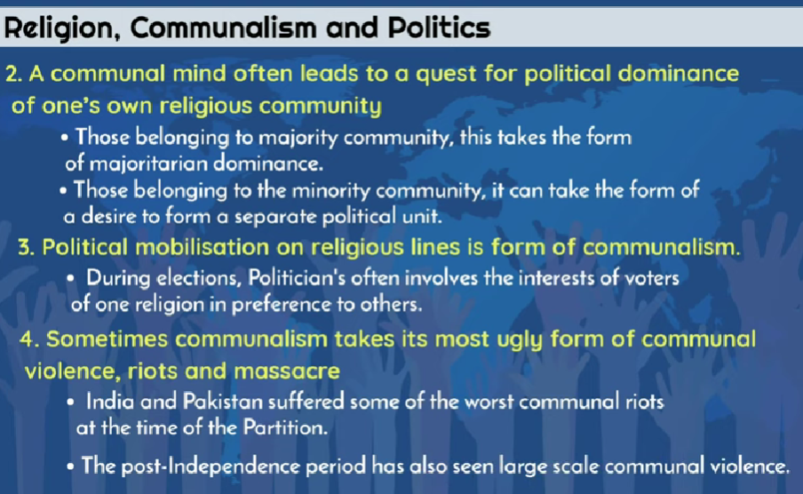

Slide 33
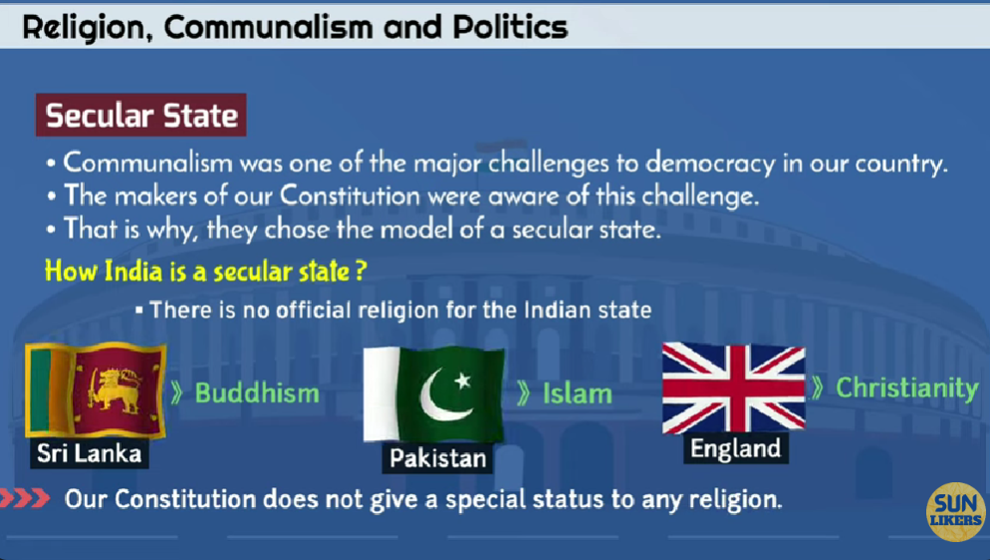

Slide 34
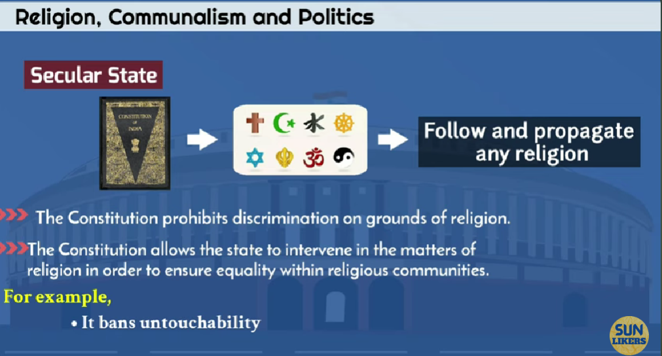

Slide 35
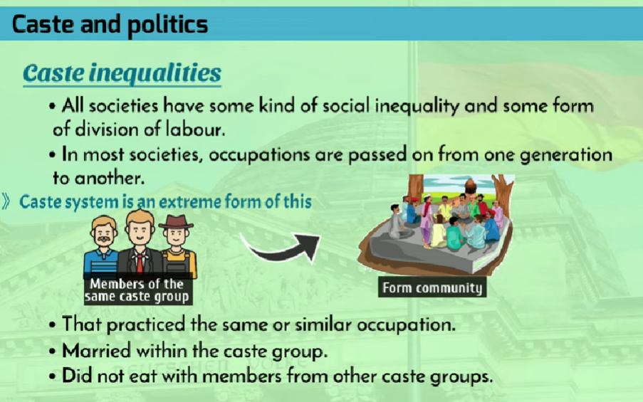

Slide 36
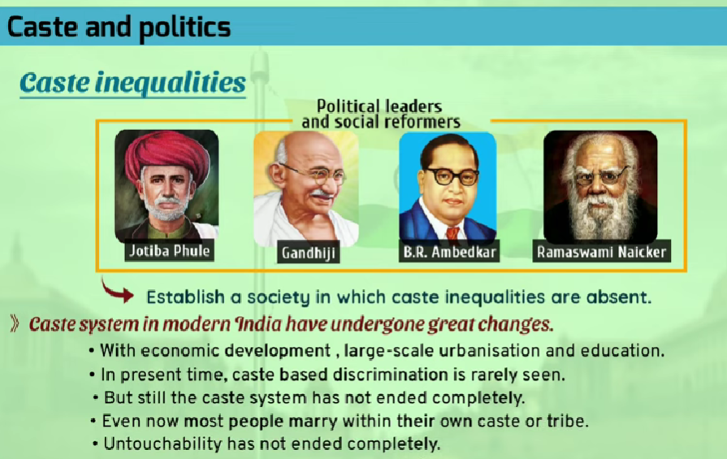

Slide 37
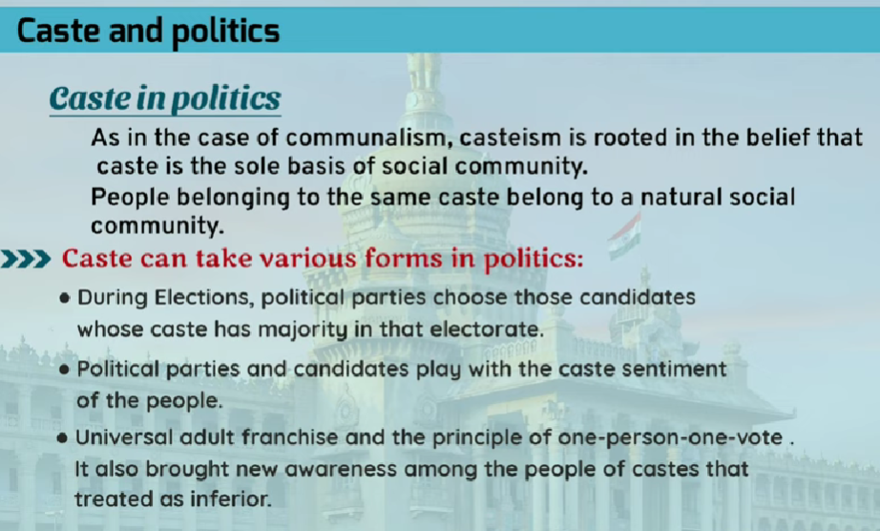

Slide 38
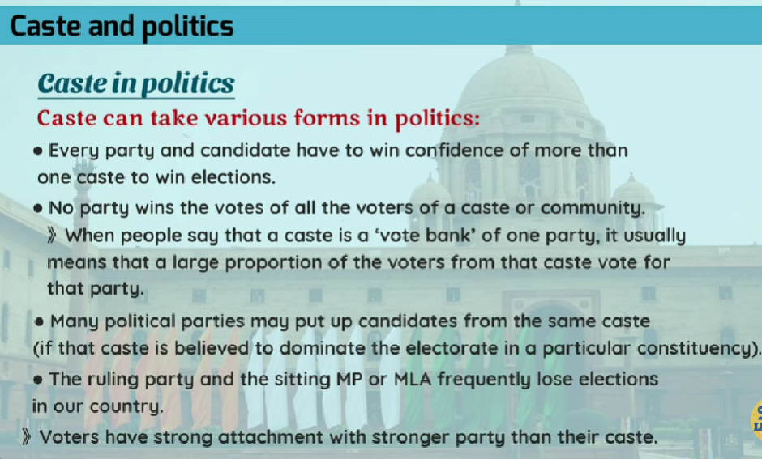

Slide 39


Slide 40


